Slide 1
The GDF11 Controversy
Brian Bower, Ph.D.
Miller Lab
October 1, 2015

Slide 2
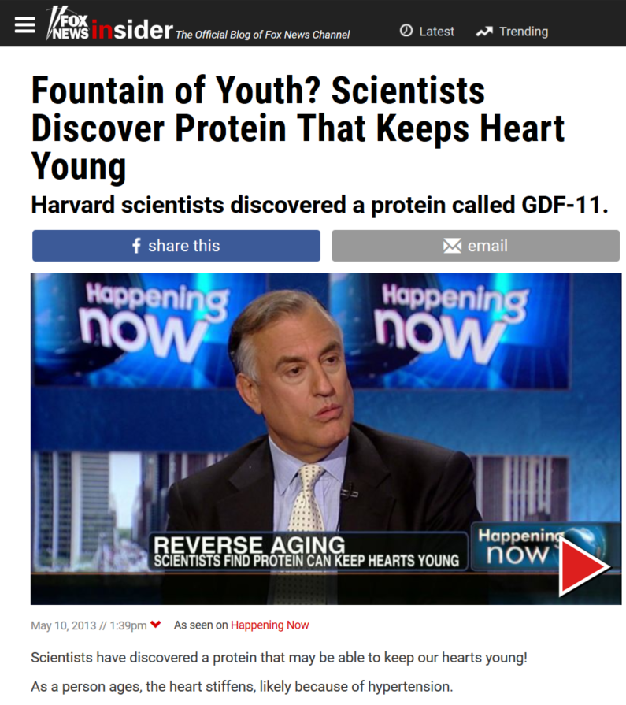
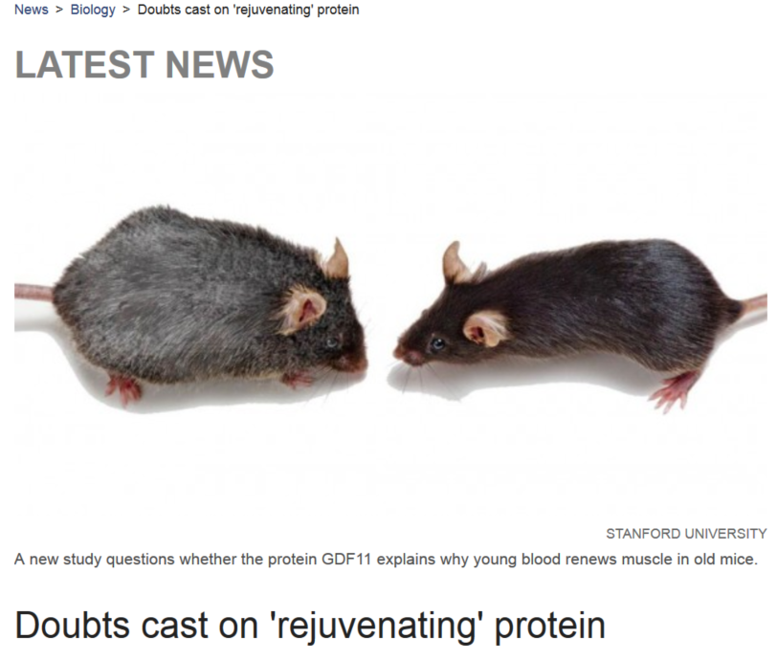
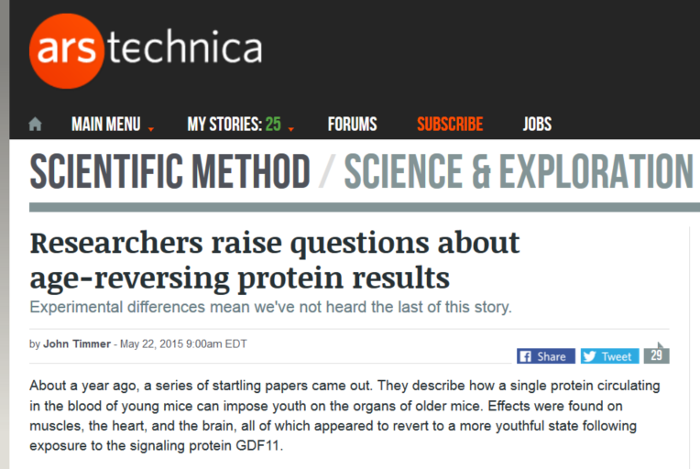
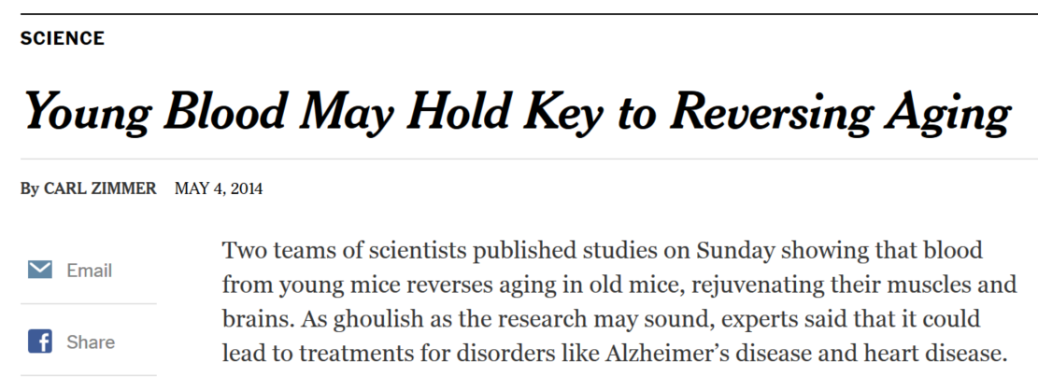
A big to do about nothing?
…2015
2013 – 2014…

Slide 3
I almost proposed GDF11 work in the T32
Investigating the Use of Orally Bioavailable Histone Deacetylase Inhibitors to Modulate GDF11 Expression
…it may be possibly to induce GDF11 expression pharmacologically.
Trichostatin A (TSA) increases the expression of GDF11,
likely via histone deacetylase (HDAC) inhibition.
TSA also decreases expression of follistatin (FST),
a GDF11 and MSTN antagonist².
Orally available HDAC inhibitors may promote GDF11 expression in similar manner...
Ultimately decided other work seemed more promising

Slide 4
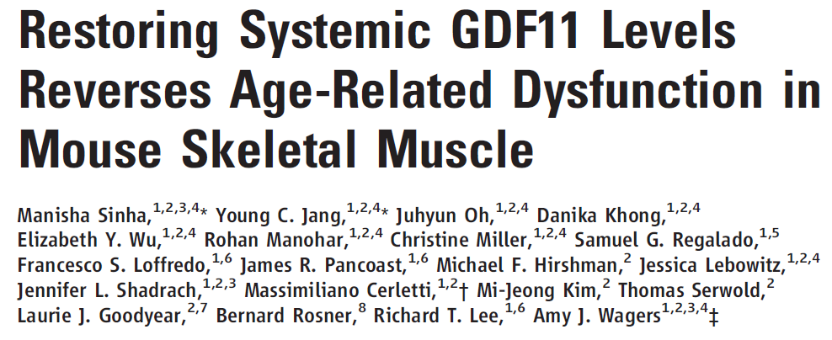
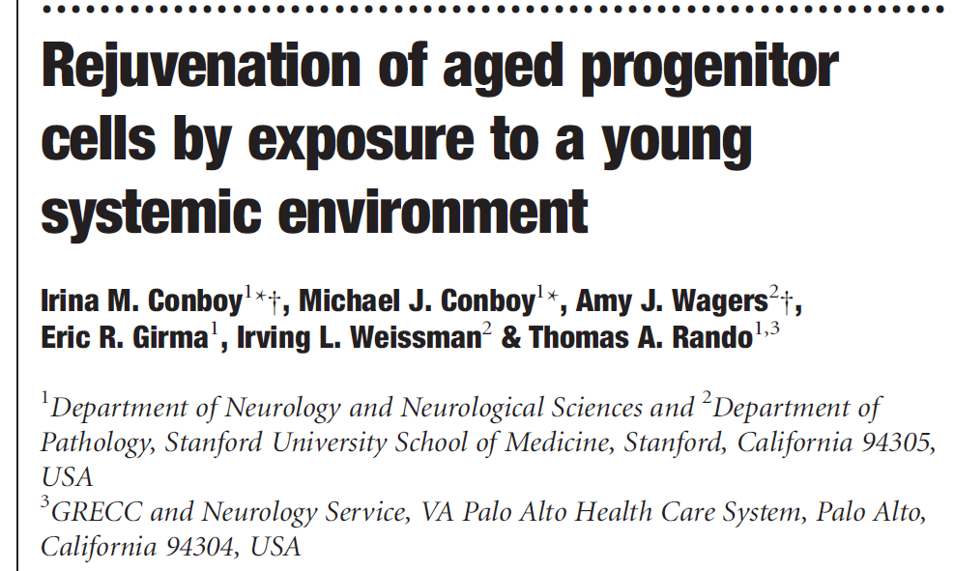
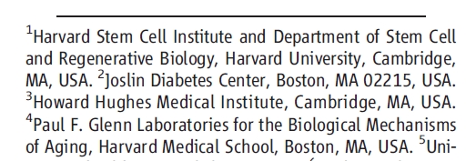
History / Genealogy of the GDF11 Controversy
UM
Harvard
Novartis
Stanford
GRECC
Amy Wagers, Ph.D., Associate Professor of Stem Cell and Regenerative Biology, Investigator, Joslin Diabetes Center, Investigator HHMI, Harvard Medical School.
Lecture Title: "Programming and Reprogramming Skeletal Muscle"

Slide 5
Today’s Paper:
“Recent studies showed an age-related decrease in GDF11
and that GDF11 treatment improves muscle regeneration…
…we now show that these recent claims are not reproducible and the reagents previously used to detect GDF11 are not GDF11 specific.
…GDF11 actually increases with age and has
deleterious effects on aging skeletal muscle.”

Slide 6
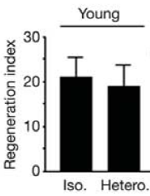
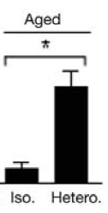
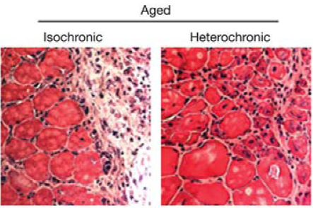
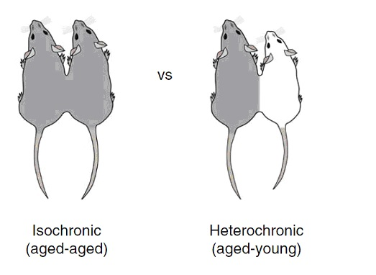
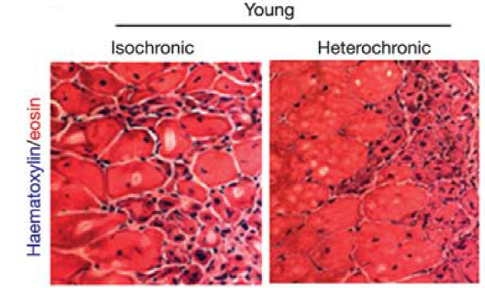
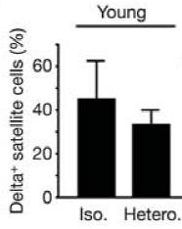
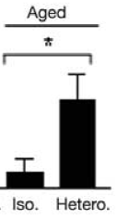
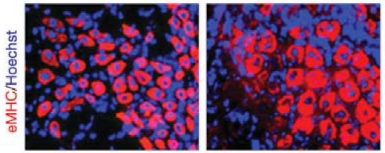
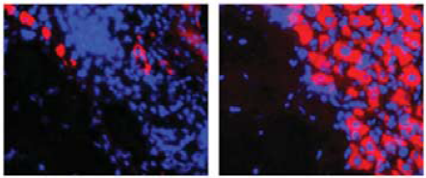
Background: Mouse Parabiosis and Young Blood
Studied how youthful serum, etc. affected aging-related pathologies using heterochronic parabiosis.

Slide 7
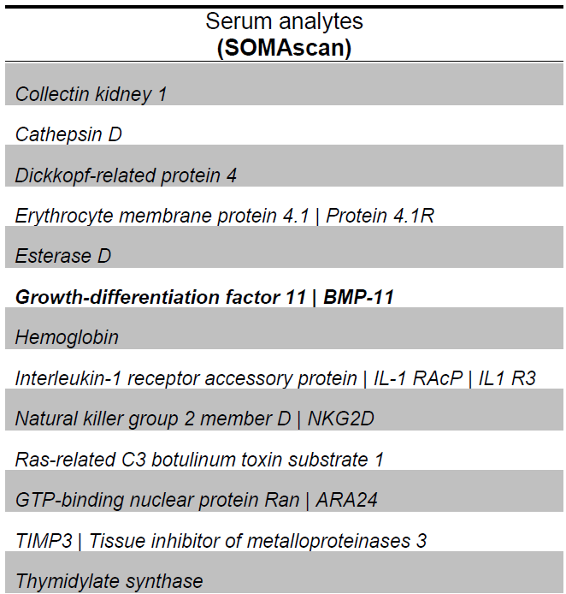
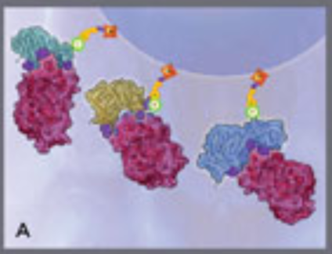
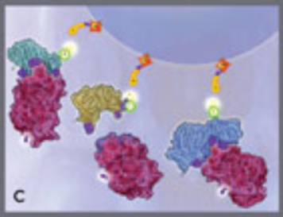
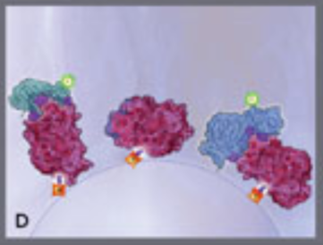
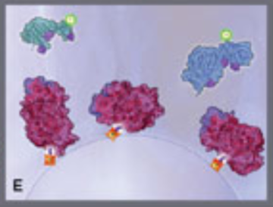
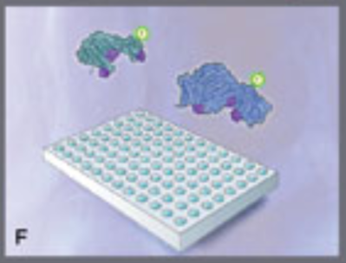
Background: GDF11, the youthful serum factor?
Glass et al. claims the anti-GDF11 SOMAmer isn’t specific for GDF11
Bound proteins are biotinylated at Lys & N-term
It’s also worth asking, if there’s a SOMAmer against Myostatin
Proteins bind to SOMAmers
SOMAmers are photo-cleaved
Eluate binds to new streptavidin
Used an aptamer-based proteomics screen to identify GDF11 as a possible youthful serum factor.
SOMAmers eluted
SOMAmers measured by microarray
2015↑

Slide 8
SOMA Logic Response
Hi Brian, Thanks for your question about SomaLogic's reagents - specifically for GDF11/8. I am gathering additional details and will have a full response for you in the next couple of days. The version of the assay used in the Wagers Cell paper included only a single GDF11-targeted SOMAmer that also binds GDF8 with similar affinity. The new version of the assay includes SOMAmers that can differentiate between the two. I look forward to discussing it further. Thanks, Cole Zimmerman, PhD SomaLogic (616) 227-9156

Slide 9
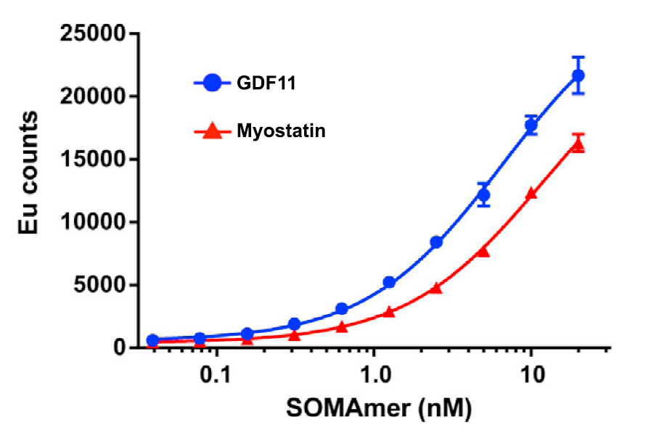
Poor reagent specificity: SOMAmer and DELFIA
Europium-Chelate→
Eu
Eu
Eu
Eu
Eu
Eu
Glass reports that the SOMAmer detects both Myostatin and GDF11 with nanomolar affinity
Dissociation Reagent→
~ ~ ~ ~ ~ ~ ~ ~ ~ ~ ~ ~ ~ ~ ~ ~ ~ ~ ~ ~ ~ ~ ~ ~ ~ ~ ~ ~ ~ ~
Glass purchased SOMAmers synthesized by IDT
Europium-Streptavidin→
Eu
Eu
Eu
Eu
Eu
Eu
Eu
Eu
Eu
Eu
Eu
Eu
Eu
Eu
SOMAmer→
Y
Y
Y
Y
Y
Y
Y
Y
Y
Y
Y
Y
Y
Y
Dissociation
Protein→
Enhanced
Lanthanide
DELFIA Plate
But SomaLogic sells the SOMAmers individually
GDF11
Myostatin
Fluorescent
Why not use the genuine article?
ImmunoAssay

Slide 10
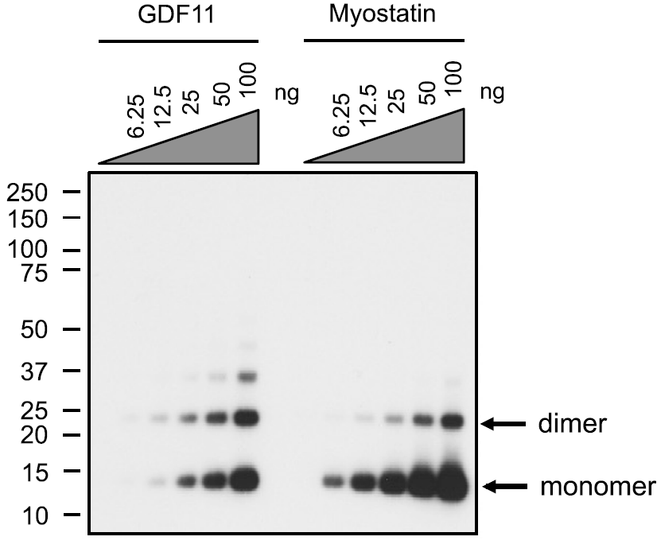
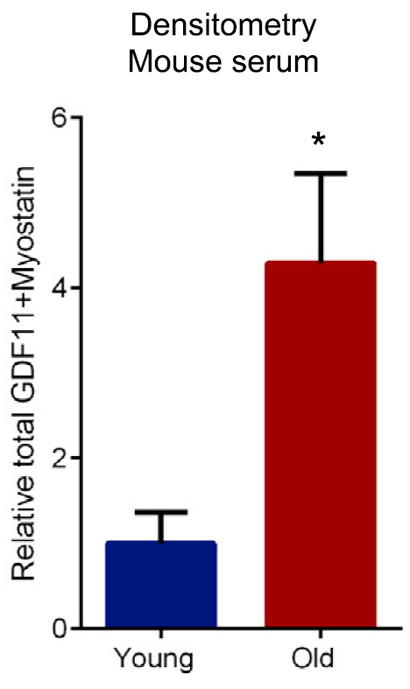
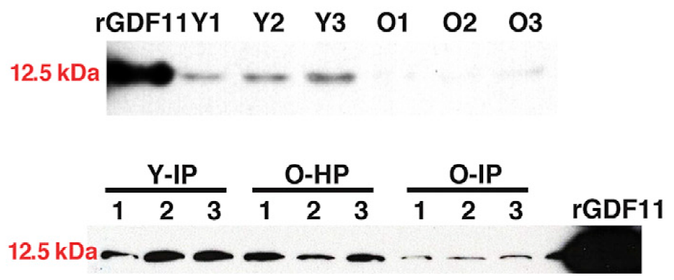
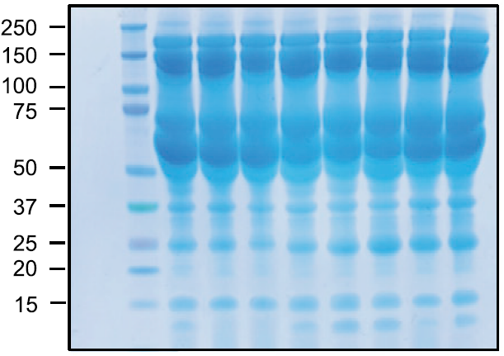
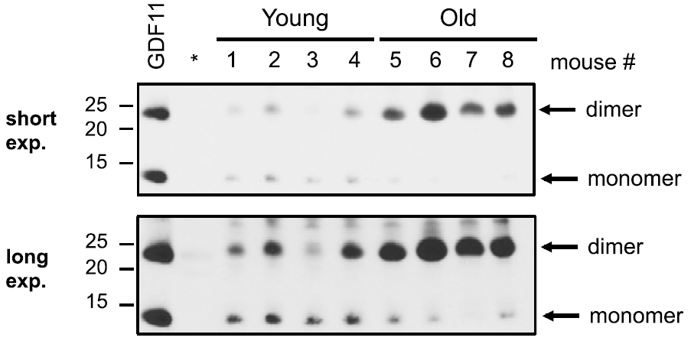
Poor reagent specificity: Antibodies and Blots
Glass’s quantification of the lower-mobility bands actually suggested that GDF11 increased with age.
Wager et al. did attempt to confirm her findings by western
This is a problem since Myostatin and GDF11 have 90% sequence identity and nearly identical mass
Glass found that the antibody
cross-reacted with Myostatin
GDF11 1 NLGLDCDEHSSESRCCRYPLTVDFEAFGWDWIIAPKRYKANYCSGQCEYMFMQKYPHTHL
Myostatin 2 DFGLDCDEHSTESRCCRYPLTVDFEAFGWDWIIAPKRYKANYCSGECEFVFLQKYPHTHL
******** ********************************** ** * ********
GDF11 61 VQQANPRGSAGPCCTPTKMSPINMLYFNDKQQIIYGKIPGMVVDRCGCS
Myostatin 62 VHQANPRGSAGPCCTPTKMSPINMLYFNGKEQIIYGKIPAMVVDRCGCS
* ************************** * ******** *********
Glass also reported the western detects multiple bands, which were not shown in Wager’s results
But they didn’t confirm the antibody was *specific* for GDF11

Slide 11
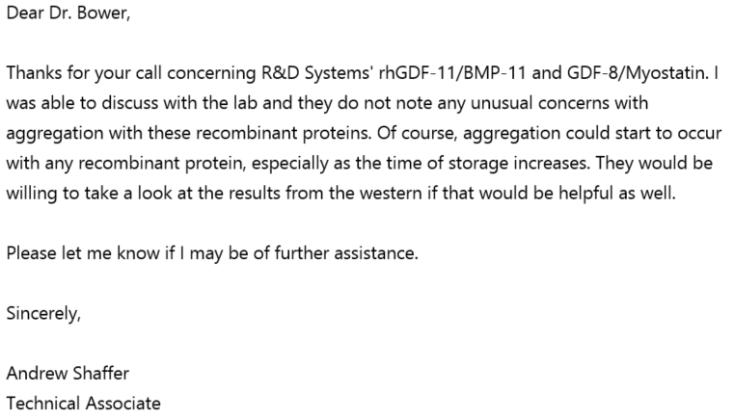
R&D Response on Aggregation
Replied asking more specifically about dimerization.
No reply as of 9/30

Slide 12
GDF11 and Myostatin Signaling
Mature GDF11 and Myostatin homo-dimerize via disulfide bonds
Wager and Glass both seem to see that GDF11 monomers decrease with age
GDF11 1 NLGLDCDEHSSESRCCRYPLTVDFEAFGWDWIIAPKRYKANYCSGQCEYMFMQKYPHTHL
Myostatin 2 DFGLDCDEHSTESRCCRYPLTVDFEAFGWDWIIAPKRYKANYCSGECEFVFLQKYPHTHL
******** ********************************** ** * ********
GDF11 61 VQQANPRGSAGPCCTPTKMSPINMLYFNDKQQIIYGKIPGMVVDRCGCS
Myostatin 62 VHQANPRGSAGPCCTPTKMSPINMLYFNGKEQIIYGKIPAMVVDRCGCS
* ************************** * ******** *********
But, Glass quantified
the dimers as well
Why is there more dimerization in old mice?
Some of these may resist denaturation
which is probably why Glass saw a ‘dimer’ band
The dimeric protein is the actual signaling molecule

Slide 13
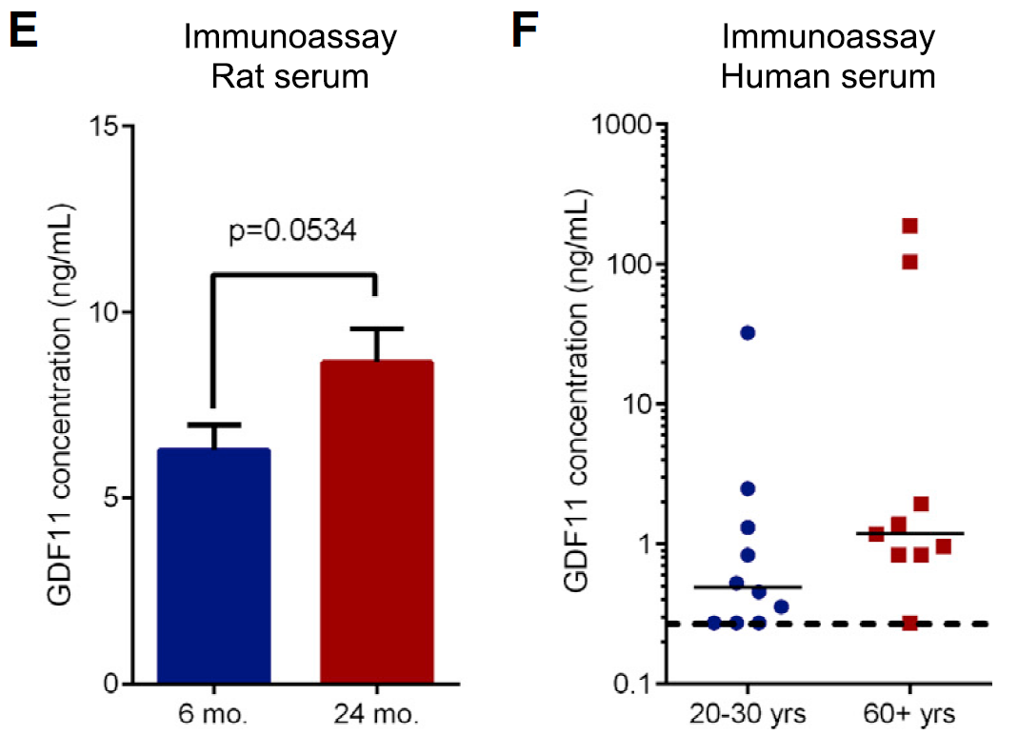
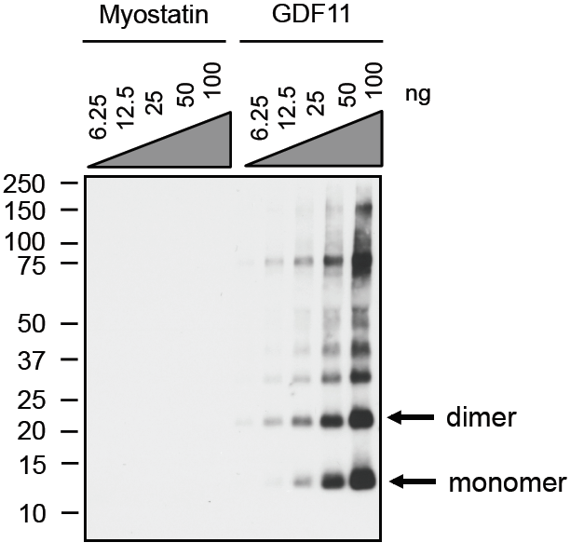
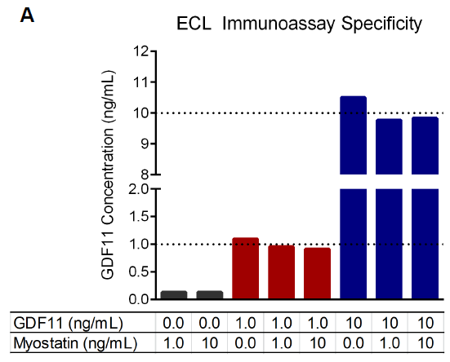
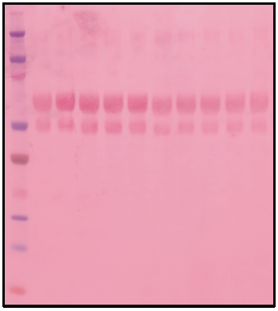
A GDF11 Specific Antibody and Assay
Glass describes a new, GDF11 specific immunoassay.
A plate based assay was also specific,
with purified proteins
Glass’ new assay suggested that GDF11 increased in aged human and rat serum.
Reading between the lines, he found an R&D monoclonal IgG that seems specific… somehow.
The western seems specific for GDF11
GDF11 1 NLGLDCDEHSSESRCCRYPLTVDFEAFGWDWIIAPKRYKANYCSGQCEYMFMQKYPHTHL
Myostatin 2 DFGLDCDEHSTESRCCRYPLTVDFEAFGWDWIIAPKRYKANYCSGECEFVFLQKYPHTHL
******** ********************************** ** * ********
GDF11 61 VQQANPRGSAGPCCTPTKMSPINMLYFNDKQQIIYGKIPGMVVDRCGCS
Myostatin 62 VHQANPRGSAGPCCTPTKMSPINMLYFNGKEQIIYGKIPAMVVDRCGCS
* ************************** * ******** *********
Wager used plasma,
And younger ‘young’ mice
← Unclear what this is
This is supposed to be ‘pure’ protein
ABCAM Antigen
R&D Antigen

Slide 14
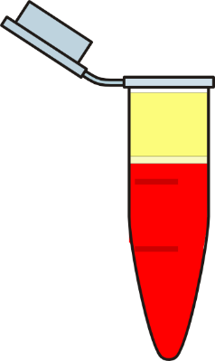
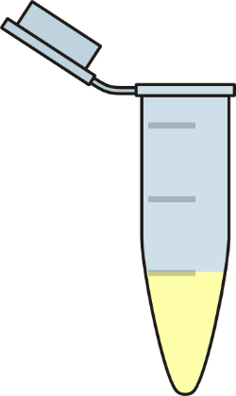
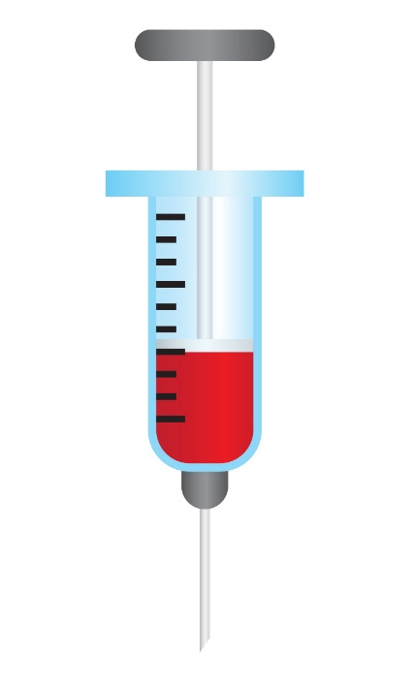
Plasma vs Serum & why it matters
Plasma
Clotting Inhibited
Heparin,
EDTA, etc.
Centrifuge
Decant
Blood
No
treatment
Centrifuge
Decant
Clotting Permitted
Serum

Slide 15
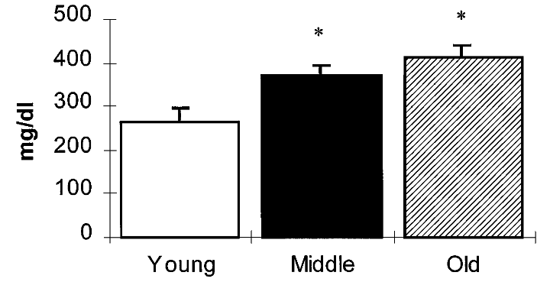
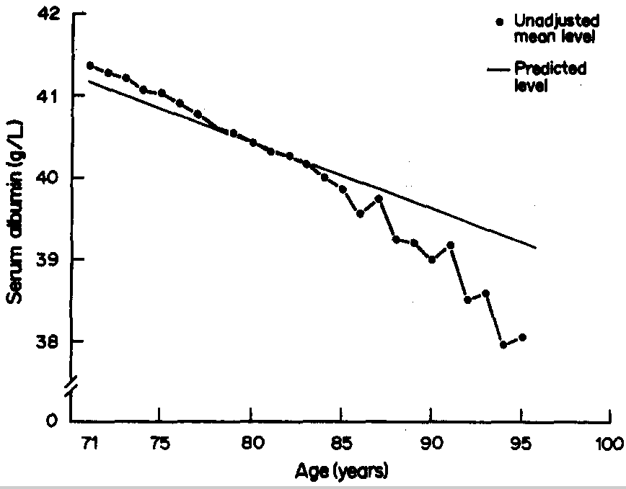
Plasma vs Serum & why it matters
Human Plasma Proteins consist of about:
55% Albumin
↓
38% Globulin
7% Fibrinogen
↑
↑
<1% Other
↓
Fibrinogen
Albumin
Changes in the major blood proteins can affect the relative abundance of ‘Other’ proteins
…like GDF11

Slide 16
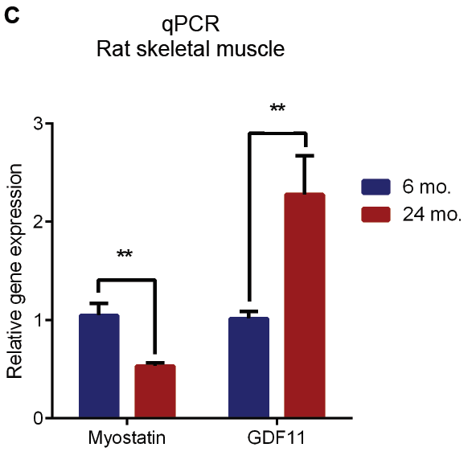
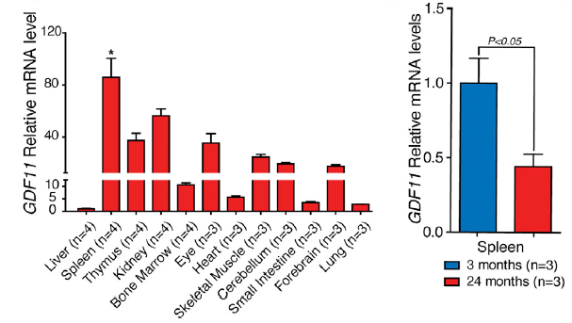
GDF11 mRNA and Age
Using nearly identical techniques Glass showed that GDF11 mRNA increased in rat skeletal muscle with age.
Wagers reported high GDF11 mRNA expression in several tissues, especially spleen, which decreased with age
This does not directly contradict Wagers findings.
Since GDF11 and Myostatin are regulated post-translationally this may not matter anyway.

Slide 17
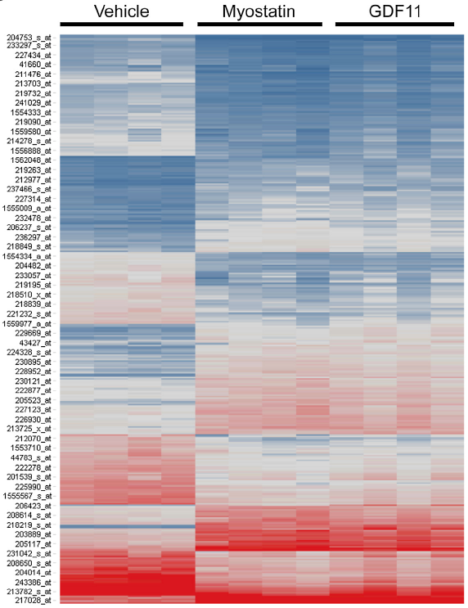
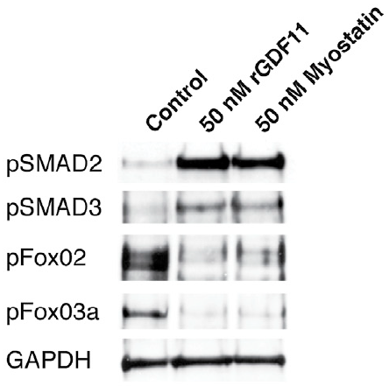
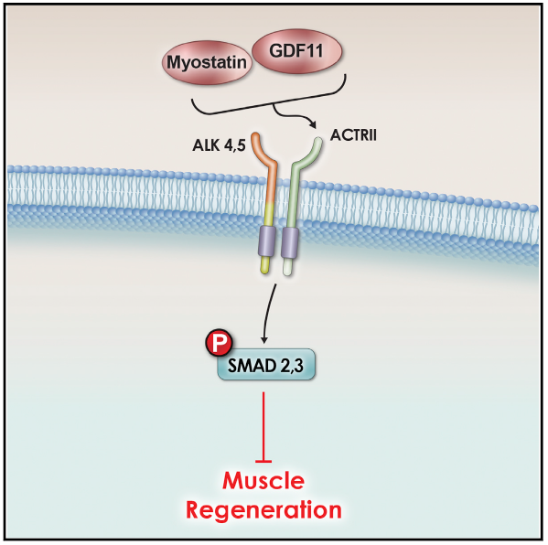
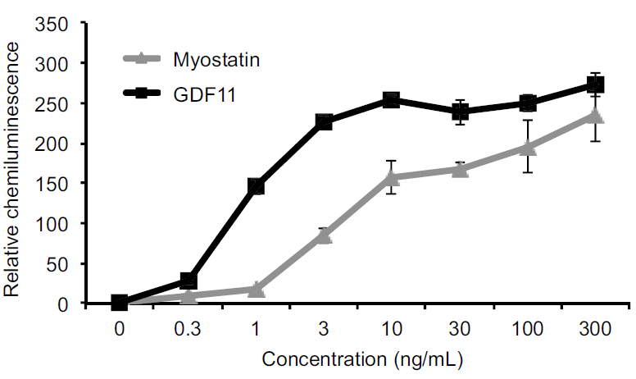
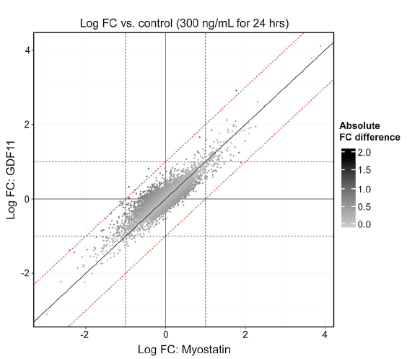
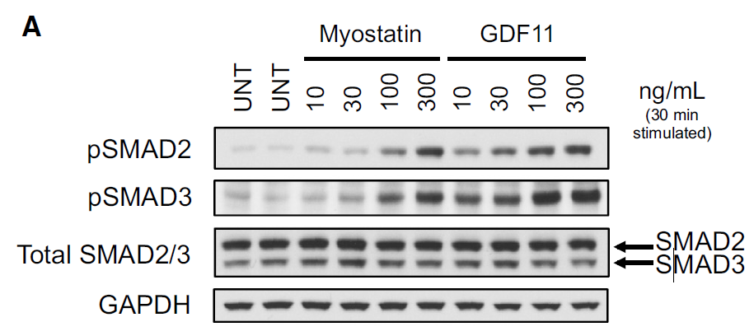
GDF11 and Myostatin Signaling
Wagers and Glass reported that GDF11 and Myostatin
Promoted SMAD2/3 phosphorylation in vitro
Glass further demonstrated that the mRNA changes induced in human myoblasts are almost identical
Human cardiomyocytes
SMAD2/3 Reporter Assay
Human myotubes

Slide 18
GDF11 and Aging Muscle
Might add some stuff here. Glass didn’t tackle the aging muscle issue as thoroughly as Wagers, so it’s hard to make direct comparisons.

Slide 19
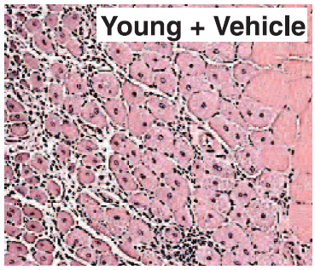
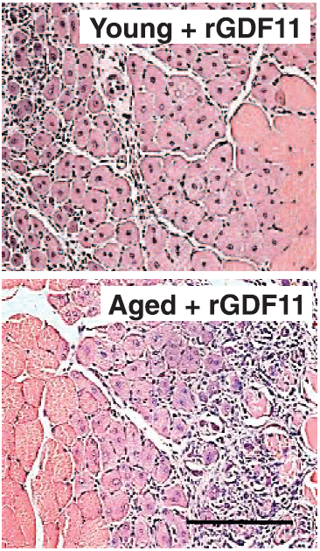
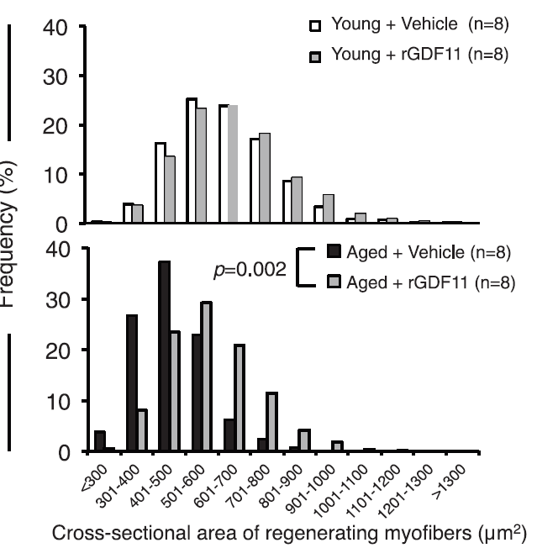
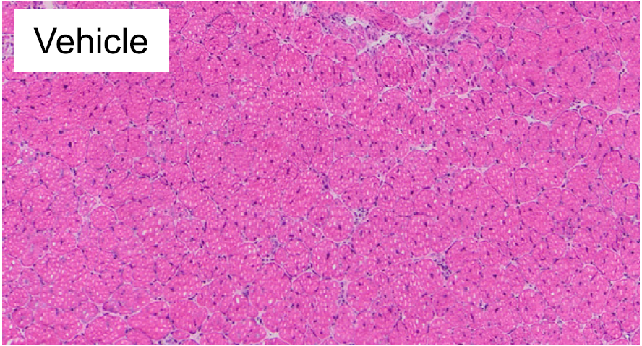
Muscle ‘Rejuvenation’: GDF11 and Myostatin
Wager claimed that GDF11 improved old mice’s recovery from muscle cryo-injury
Glass ran a separate short-term, high dose GDF11 treatment in young mice
Glass reported GDF11 did not improve cardiotoxin recovery in aged mice
... But without making a comparison between old an young mice

Slide 20
Muscle Stem Cells: GDF11 and Myostatin
Wager reported that GDF11 improved survival/proliferation of aged MSCs in vitro
Glass reported GDF11 reduced survival & proliferation of young & aged MSCs in vitro
8-12 weeks
24 months
4-month
24 months
0
25
50
0
25
50

Slide 21
Other Ongoing GDF11 research
Conclusion
…higher GDF11/8 levels are associated with lower risk of cardiovascular events and death.
Conclusions:
This study provides evidence that GDF11 improves growth parameters in peripheral blood EPCs
Conclusions:
Our studies show that there is no age-related pathological cardiac hypertrophy in disease free 24-month-old C57BL/6
mice and that restoring GDF11 in old mice has no effect on cardiac structure or function.

Slide 22
News and Comment
:

