Slide 1
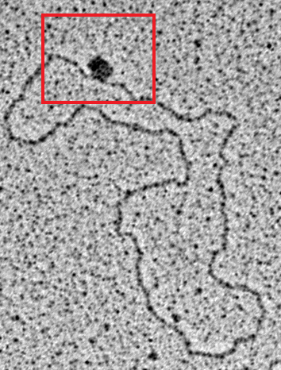
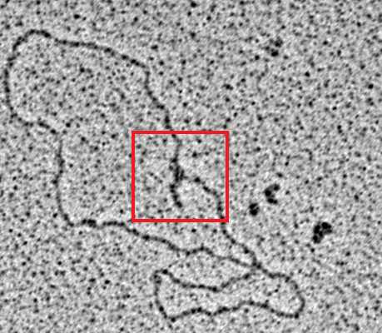
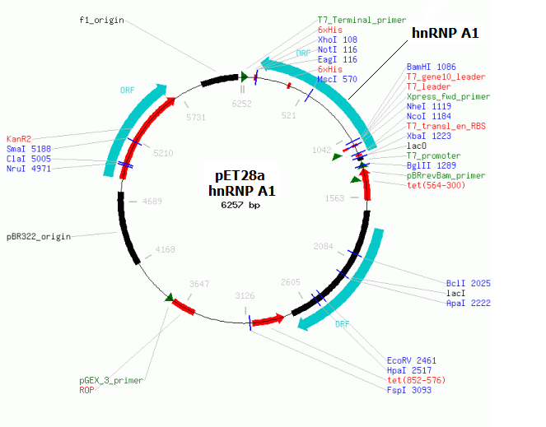
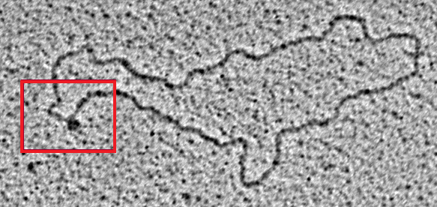
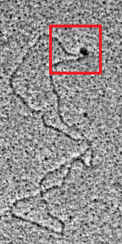
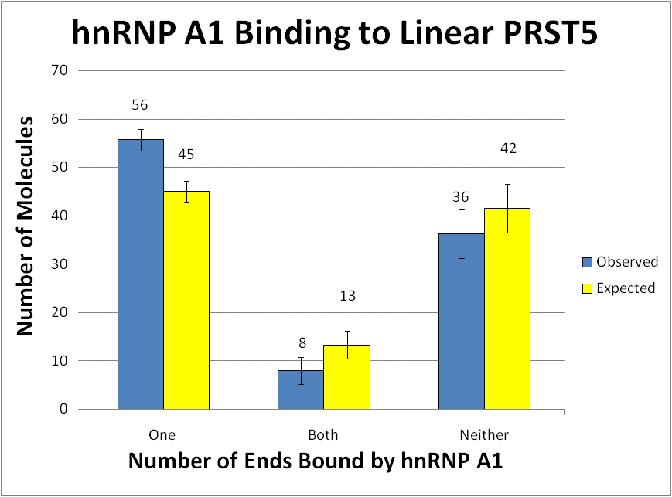
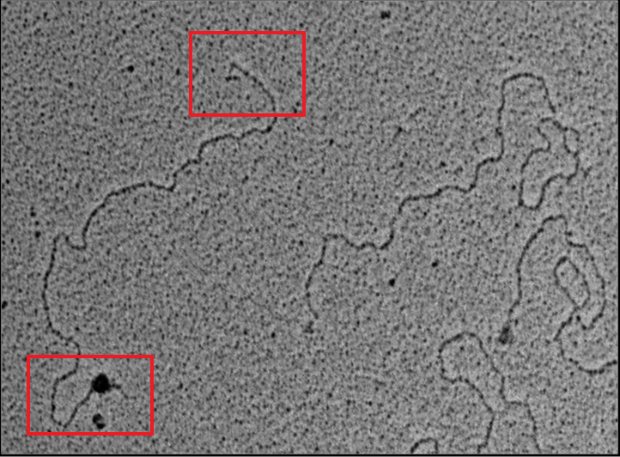
Human hnRNP A1 Preferentially
Binds to Telomeric DNA In Vitro
Brian Bower¹, Sezgin Özgür¹, Sarah Compton¹, Özlem Arat¹, Keith Schmidt¹, Jack Griffith¹
¹ University of North Carolina, Chapel Hill, NC
ABSTRACT
We demonstrate via transmission electron microscopy that HIS-Tagged human hnRNP A1 binds to DNA templates containing mammalian telomere repeats (TTAGGG) in vitro at a physiological salt concentration. Statisical analysis may indicate preferntial binding to these substrates compared to random sequences. We are actively investigating different buffer and incubation conditions to promote the formation of more organized structures using the reagents and techniques described herein.
Materials and Methods hnRNP A1 Expression and Purification
An ORF from a cDNA (NM_002136) coding for human hnRNP A1 was PCR amplified using 5’-BamHI and 3’-NotI adapter primers. This ORF was inserted into a pET28a N-Terminal HIS-tagging expression vector, and transformed in to BL21(DE2)pLysS cells using stardard techniques. These cells were induced using IPTG, and protein was solubilized via lysozyme and sonication. The soluble fraction was passed through DEAE, batch purified over Nickel-Agarose beads, and cleaned via salt-gradient with a heparin column.
Diplaced ssDNA Templates Linear ssDNA Template
Reactions:
All reactions were performed in 20mM HEPES (pH 7.5), 50mM NH₄HCO₃, 150mM NaCl 1mM βME and 1% glycerol. Each reaction contained either no hnRNP A1 or 0.5ng/μl hnRNP A1, and either no DNA or 1ng/μl of one of the above-described DNA templates. Reactions were performed at 37˚C for 30minutes, and then fixed with 0.03% glutaraldehyde for 5 minutes at room temperature.
Electron Microscopy:
The reactions were then prepared by addition of spermidine buffer to 1X, and immediately mounted to charged 400 mesh carbon-coated copper grids, where they were allowed to bind for 3 minutes at room temperature. The grids were then washed at room temperature, first with ddH2O for 3 minutes, and then dehydrated for five minutes in 25%, 50%, 75% and 100% EtOH. The samples were then air-dried, tungsten shadowed, and examined with an FEI™ Tecnai ™ transmission electron microscope.
RESULTS (continued)
On strand-displaced PRST5, hnRNP A1 readily forms complexes like those seen on linear PRST5 only in the presence of hnRNP A1.
With A1 ↑ Without A1 ↑
On strand-displaced PGL Gap, which lacks telomeric sequence, hnRNP A1 readily forms complexes similar to those found of PRT5 with or without hnRNP A1 (inconclusive).
With A1→
Without A1→
INTRODUCTION
hnRNP A1 has been implicated in the regulation of mammalian telomeres or the activity of the mammalian telomerase ribonuceloprotein complex. However, the signifigance of hnRNP A1’s interaction with the mamalian telomere, telomeric RNA, or the telomerase ribonucleoprotein complex remains unknown.
Involvement in Telomere Structure:
hnRNP A1 preferentially binds to telomeric DNA and RNA sequences (TTAGGG/UUAGGG)¹.
An hnRNP A1 fragment, UP1, can disrupt G-Quadruplexes believed to occur at mammalian telomeres in vitro² and is known to associate with mammalian telomeres in vivo².
hnRNPs form filamentous structures similar to RecA in vitro⁵, and may coat either the telomeres or telomere derived RNAs.
Involvment in Telomere Maintenance:
hnRNP A1 is specificaly phosphorylated by DNA-PK in an hTR and DNA dependent manner⁴.
hnRNP A1 stimulates telomerase activity².
A proteolytic fragment of hnRNP A1, UP1, may provide a mechanism of telomerase recruitment to the telomere³ and specifically to short telomeres³.
CONCLUSIONS
Human hnRNP A1 binds to DNA templates containing mammalian telomere repeats (TTAGG) in vitro at physiological salt concentration.
Human hnRNP A1 may also bind promiscuously to other DNA templates in vitro (requires repeating).
Structure of hnRNP A1/Telomere complex remains to be determined (Cryo-EM & Single-Particle Reconstruction)
RESULTS
hnRNP A1 interaction with linear PRST5 is non-random
Pearsons Chi-Squared showed a non-random distribution of PRST5 molecules with only one end bound by hnRNP A1 (Sig.<0.001).
REFERENCES
Biochemistry. 1996 Mar 19;35(11):3545-54.
RNA. 2006 Jun;12(6):1116-28. Epub 2006 Apr 7.
Nucleic Acids Res. 2001 Jun 1;29(11):2268-75.
Nucleic Acids Res. 2009 Oct;37(18):6105-15.
MCB. Vol. 11, Issue 5, 1547-1554, May 2000

